Slide 1









ADAMAS UNIVERSITY DATA
REPOSITORY SYSTEM
GROUP-2
Notes:
https://unsplash.com/photos/AXu2aZ3YgP8

Slide 2

INTRODUCTION

Slide 3


INTRODUCTION
ADAMAS UNIVERSITY DATA REPOSITORY SYSTEM is a repository system for all the faculties of ADAMAS UNIVERSITY.
ONE PLACE FOR ALL PUBLICATIONS
Notes:
https://unsplash.com/photos/fItRJ7AHak8

Slide 4

PROBLEM

Slide 5



PROBLEM
NON AVAILABILITY SCHOOL WISE PUBLICATIONS
NOT SORTED
NOT EASILY ACCESSIBLE
PAID SUBSCRIPTION [https://adamasuniversity.irins.org]
Notes:
https://unsplash.com/photos/48nerZQCHgo

Slide 6

SOLUTION

Slide 7


SOLUTION
EASY TO FIND
WELL MANAGED
SORTED SCHOOL WISE
FREE SYSTEM
Notes:
https://unsplash.com/photos/TvN54bnuQg8

Slide 8

TECHNOLOGY
USED

Slide 9


TECHNOLOGY
USED
MONGODB
EXPRESS JS
REACT JS
NODE JS
Notes:
https://unsplash.com/photos/GKLIsLZxhj0

Slide 10
TECHNOLOGY
USED
REACT JS
React is used for front end of this project
We have used React 18.2.0
Notes:
https://unsplash.com/photos/GKLIsLZxhj0

Slide 11
TECHNOLOGY
USED
NODE JS
&
EXPRESS JS
Express JS a Framework of a Node JS.
Express is used for the backend server
We have NODE 1.0.0
and EXPRESS version 4.18.1
Notes:
https://unsplash.com/photos/GKLIsLZxhj0

Slide 12
TECHNOLOGY
USED
MONGODB
MongoDB is a database tool that is used in this project.
We have used MONGODB ATLAS
Notes:
https://unsplash.com/photos/GKLIsLZxhj0

Slide 13

PREVIEW

Slide 14
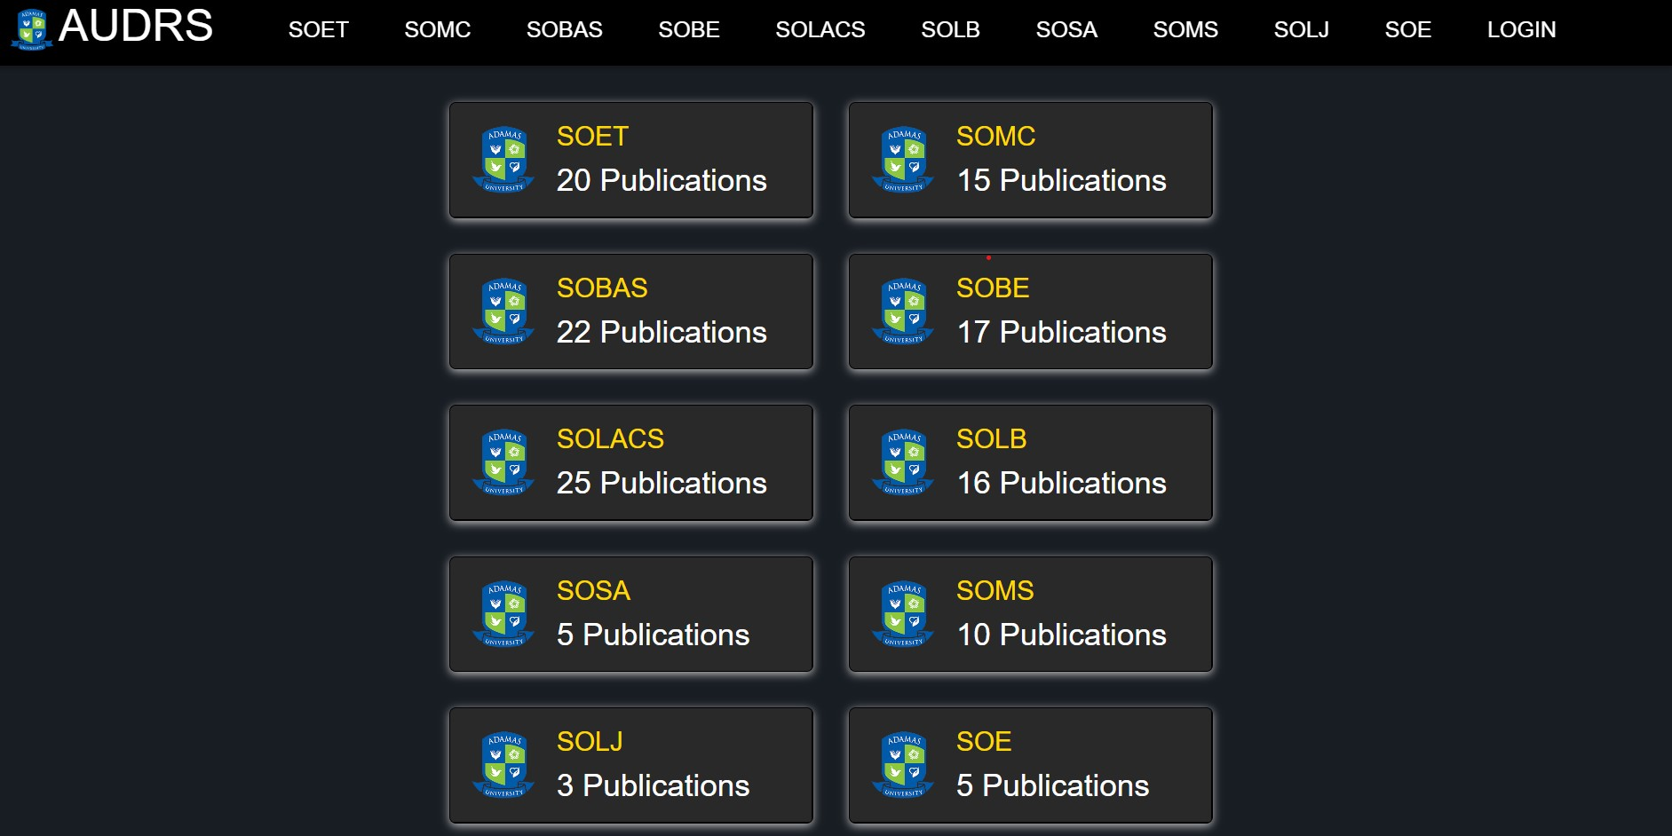

Slide 15
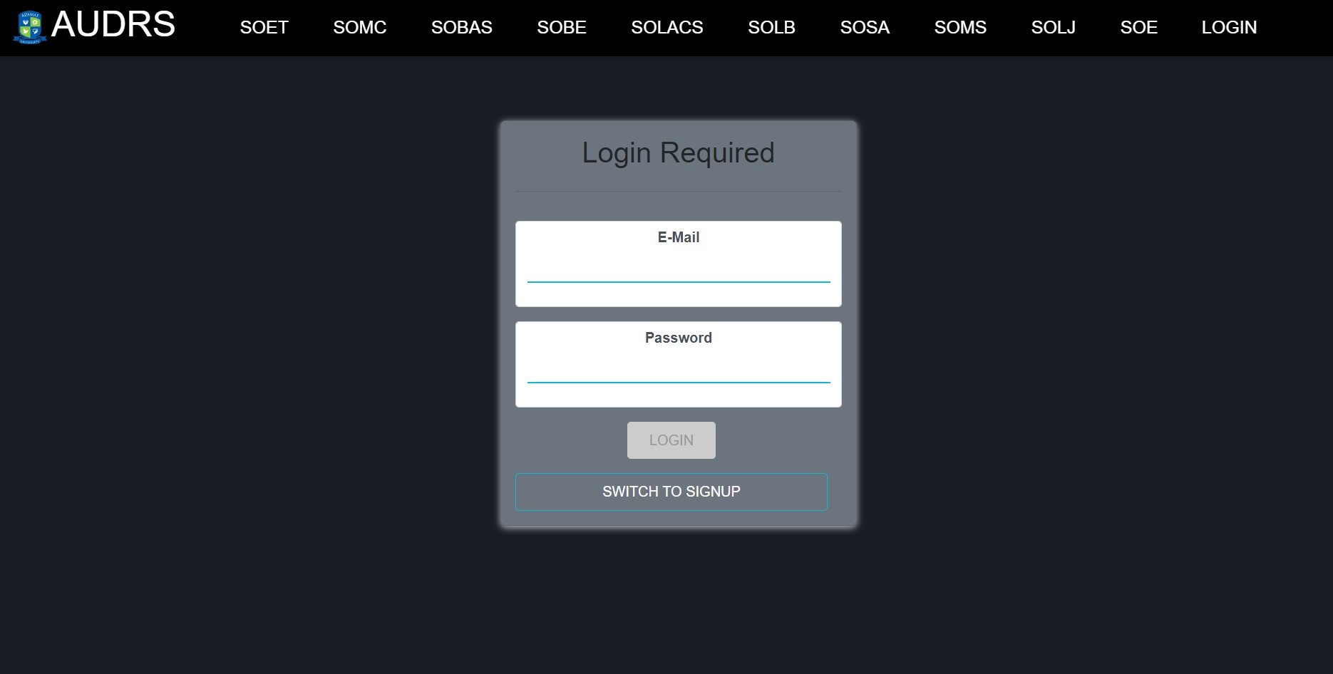
ADAMAS E-MAIL
ADAMAS E-MAIL PASSWORD

Slide 16

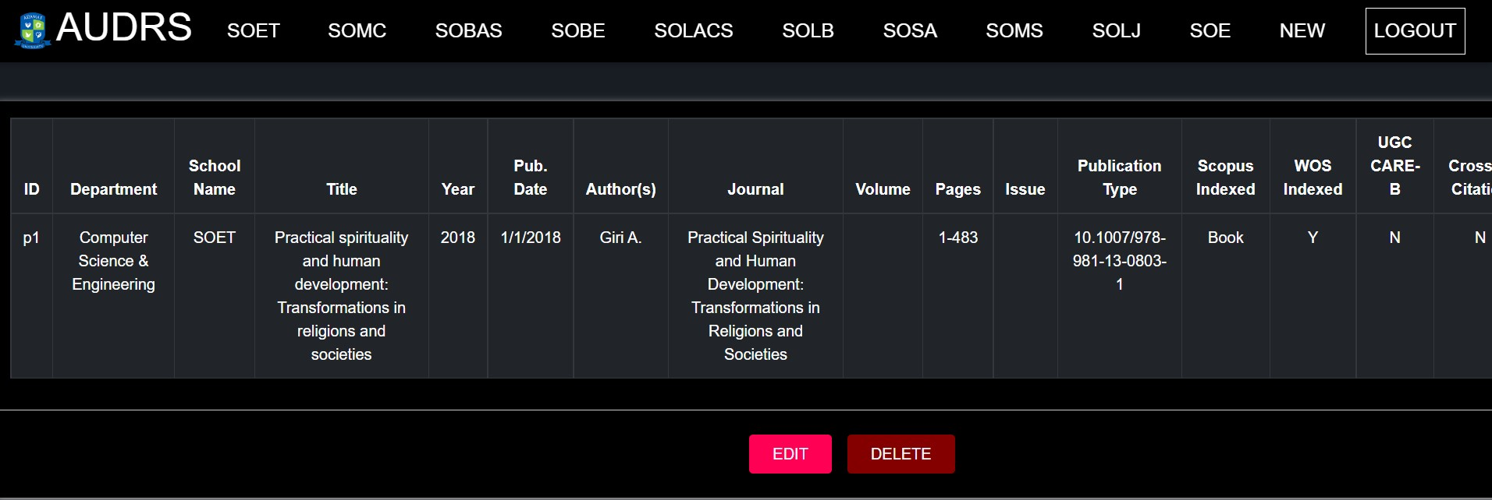

Slide 17

FUTURE SCOPE

Slide 18
FUTURE SCOPE
INCLUSION OF STUDENT ACCESS
OPEN FOR ALL
INCLUSION OF DOWNLOAD OPTION
Notes:
https://unsplash.com/photos/TvN54bnuQg8

Slide 19

THE TEAM

Slide 20



THE TEAM
SRABON KUMAR GHOSH
ROLL-84
RIDDHI ACHARYA
ROLL-67
RAVI SHARMA
ROLL-64
AMITRAJIT CHATTOPADHYAY
ROLL-16

Slide 21

THANK YOU

